Slide 1
Web development
Student: Nicole Jade D. Fernandez 潔妮可
Teacher: My dear great teacher

Slide 2
agenda
Web programming
Web server and database
HTML programming
CSS
Server side programming (PHP)
JAVAscript
My funny web site

Slide 3

XAMPP
Xampp is a stack server which contains Apache HTTP Server, Maria DB database, and interpreters for scripts written in the PHP and Perl programming languages.

Slide 4
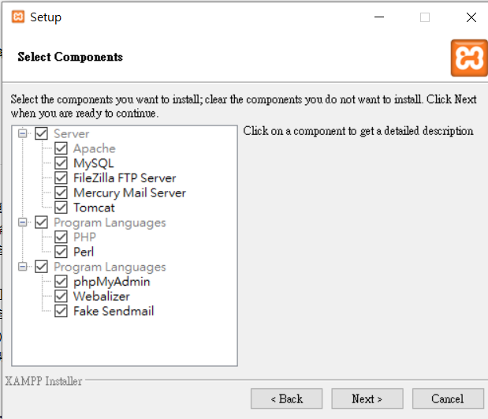
PROGRAM LANGUAGES is a language in technology which use different kind of codes for outputs in programming or Technology.

Slide 5
https://en.wikipedia.org/wiki/Webalizer

Slide 6
phpMyAdmin is a free software tool written in PHP
A web interface for MySQL and MariaDB.
https://docs.phpmyadmin.net/,

Slide 7
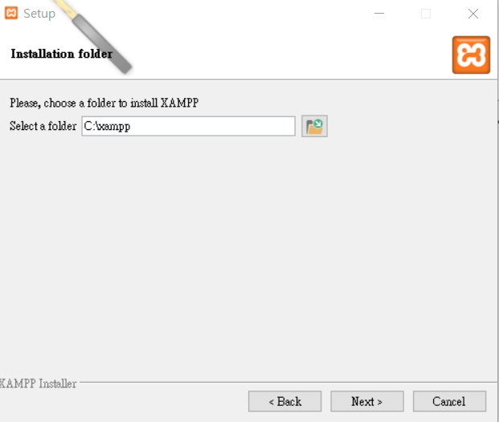

Slide 8
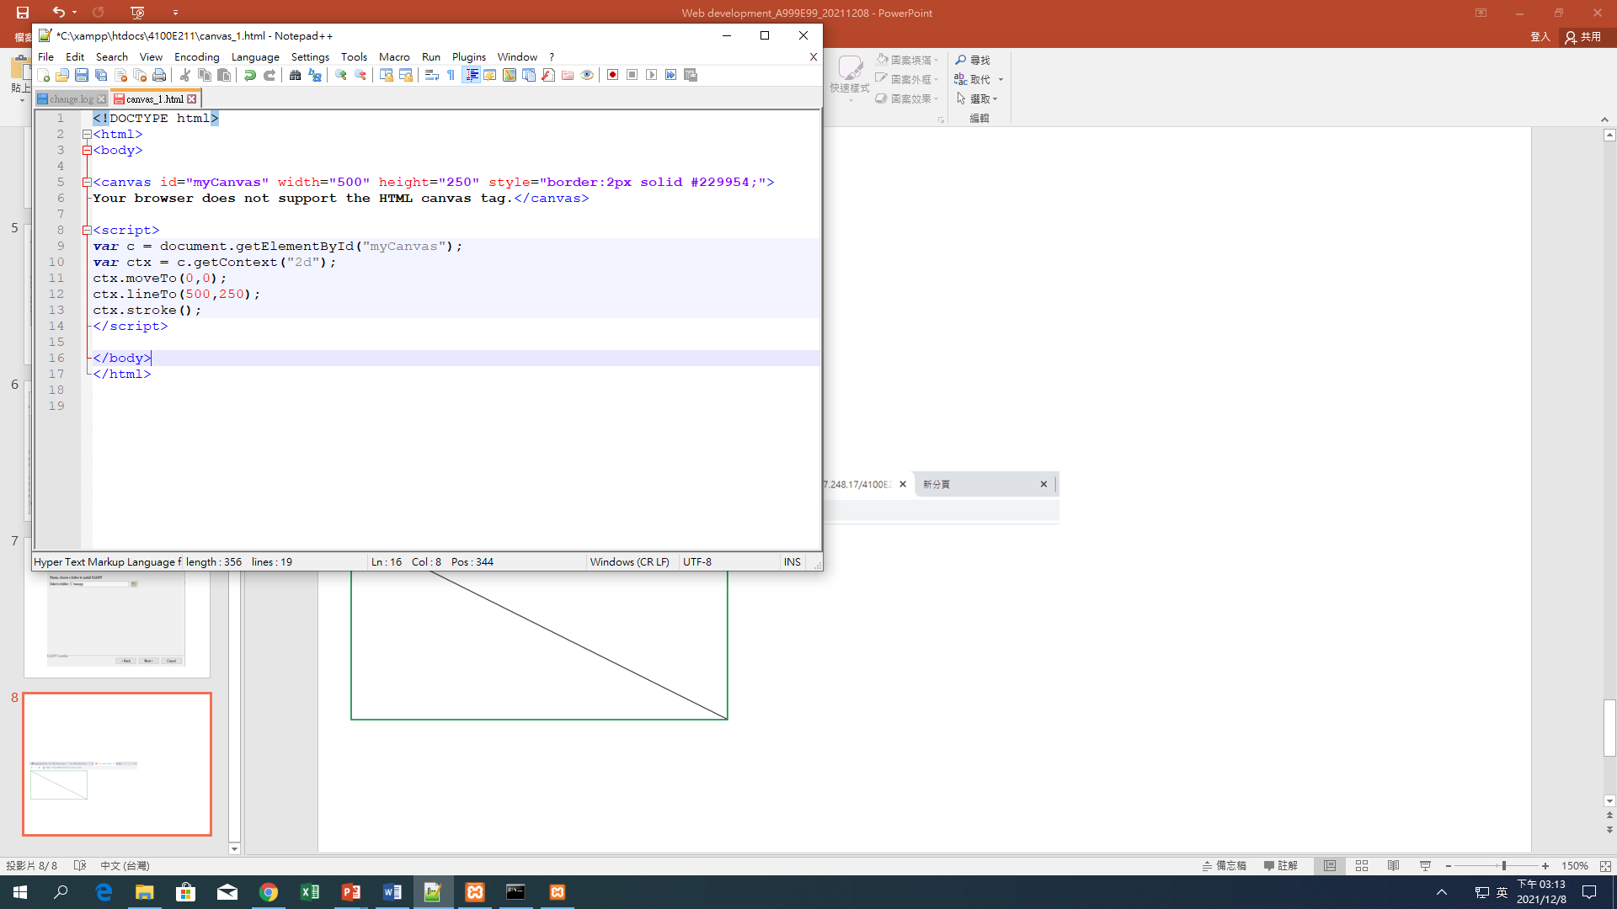
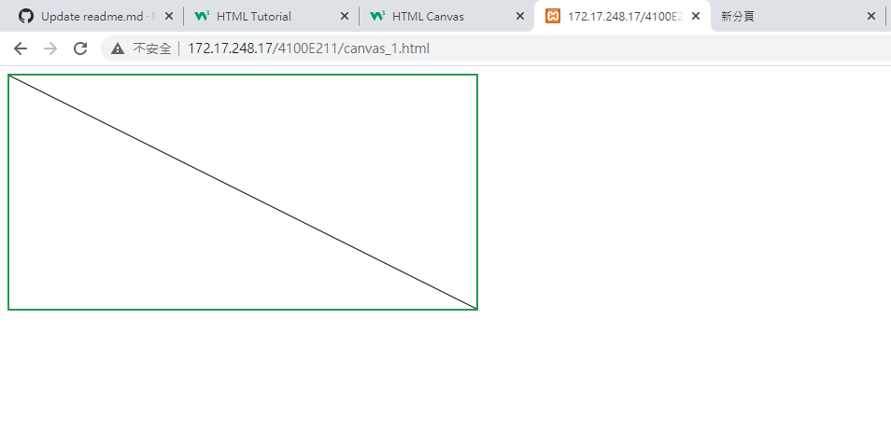
XAMPP HTML PROGRAMMING
(CANVAS - LINE)

Slide 9
Html

Slide 10
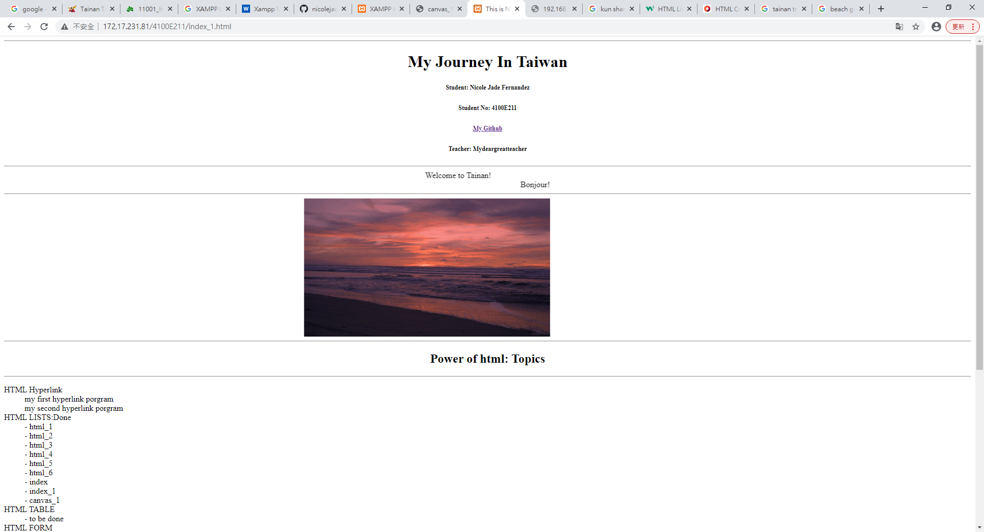
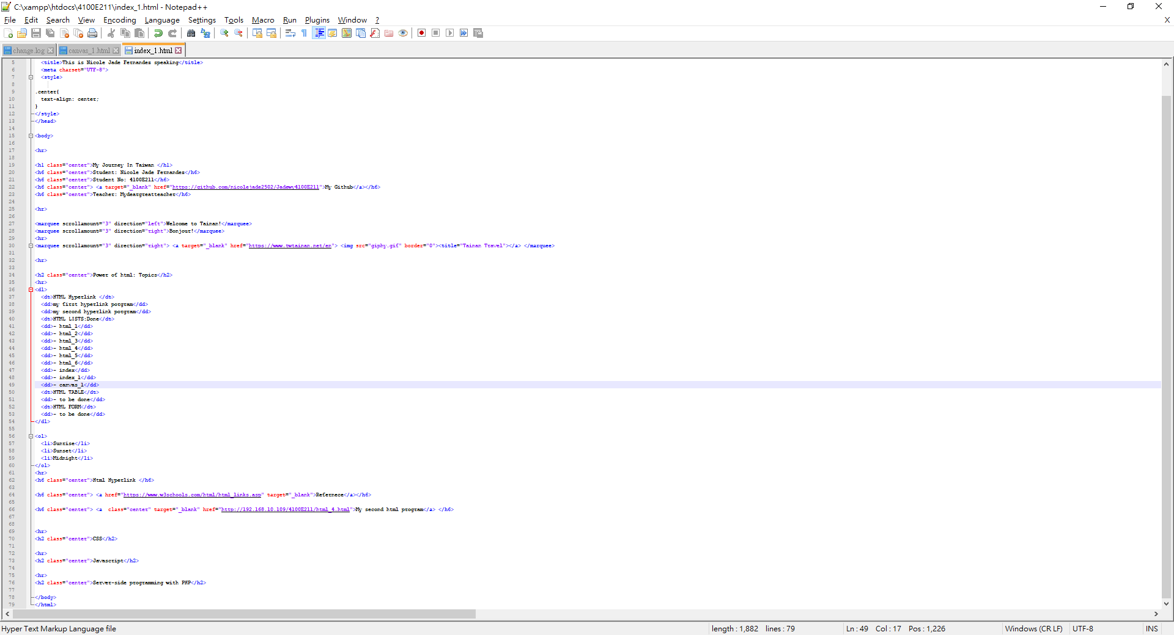
Index_1.html

Slide 11
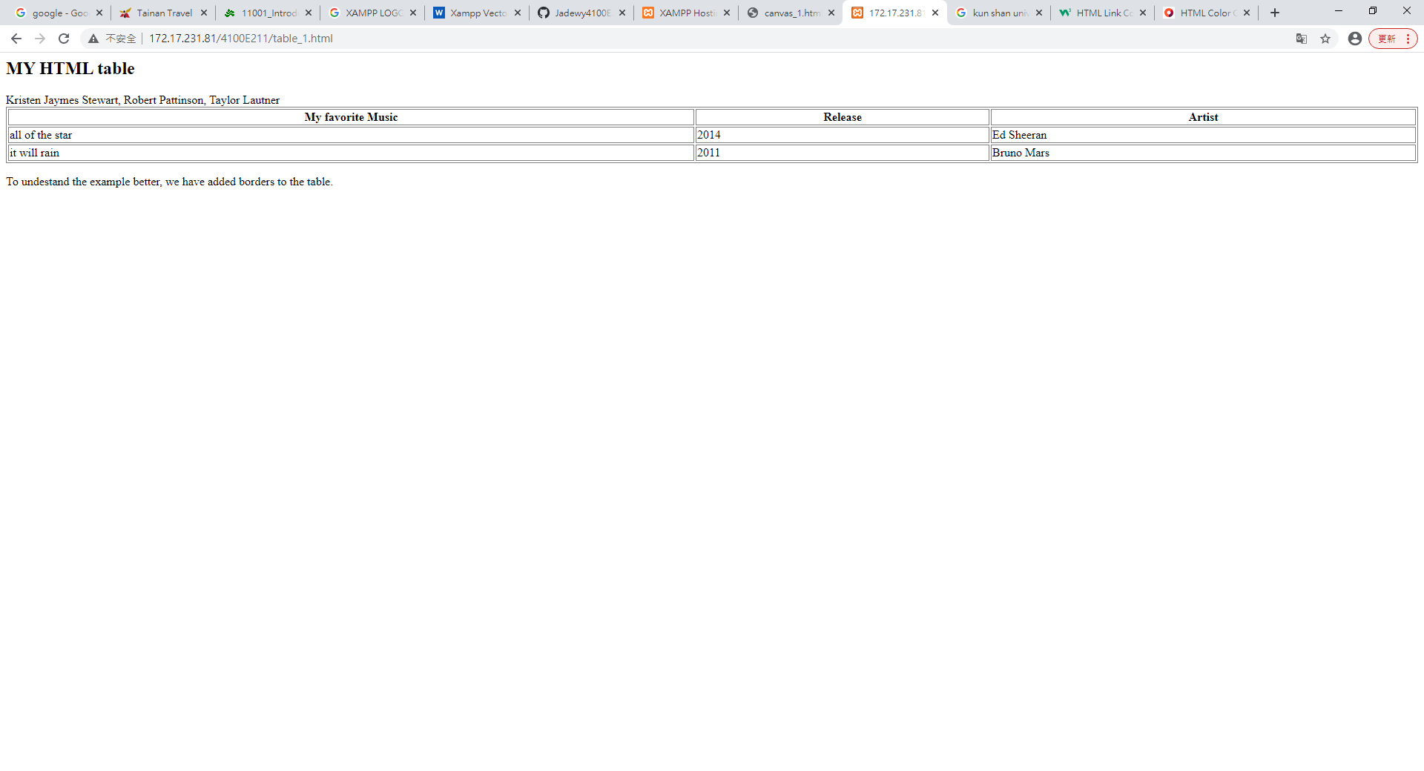
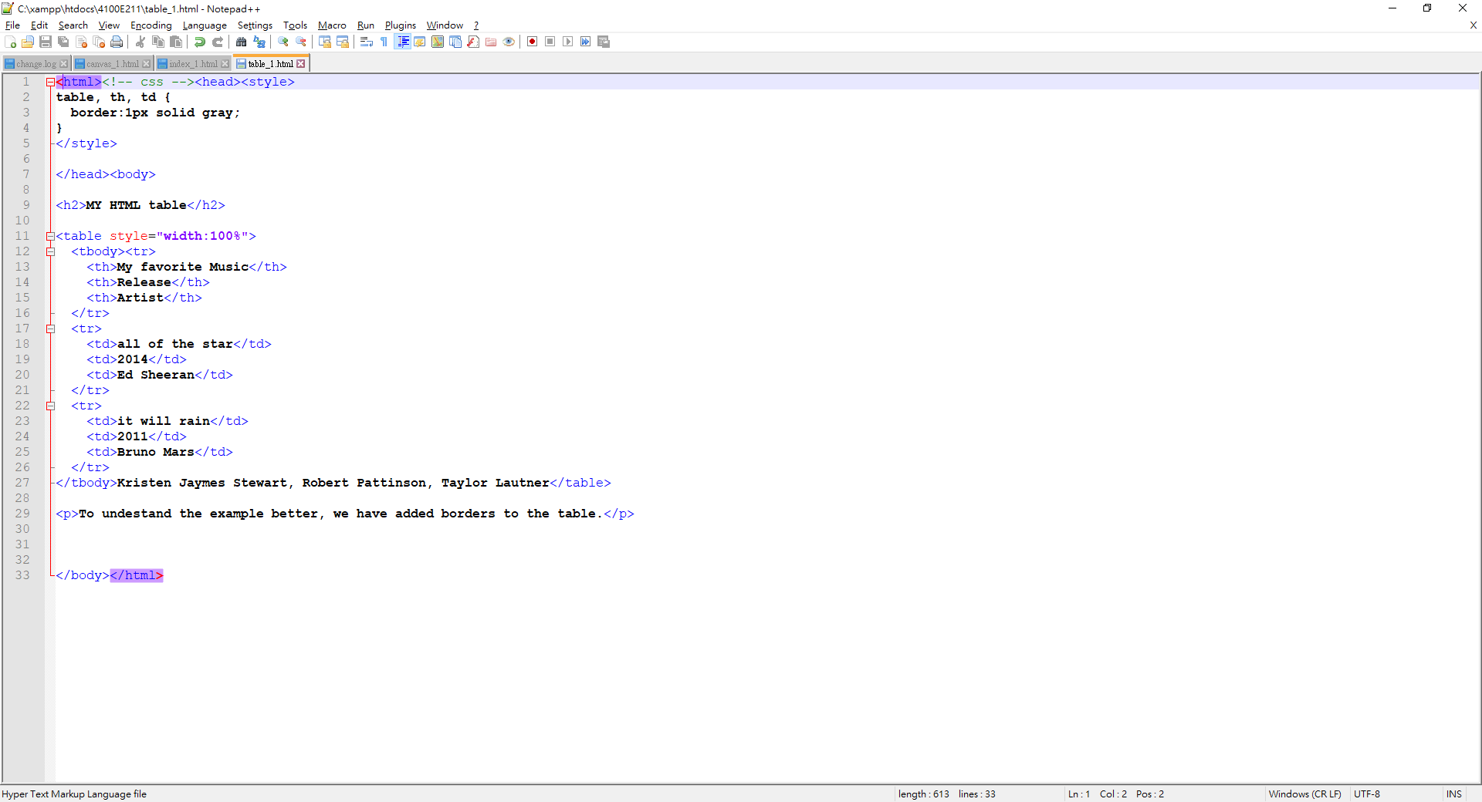
Table_1.html

Slide 12
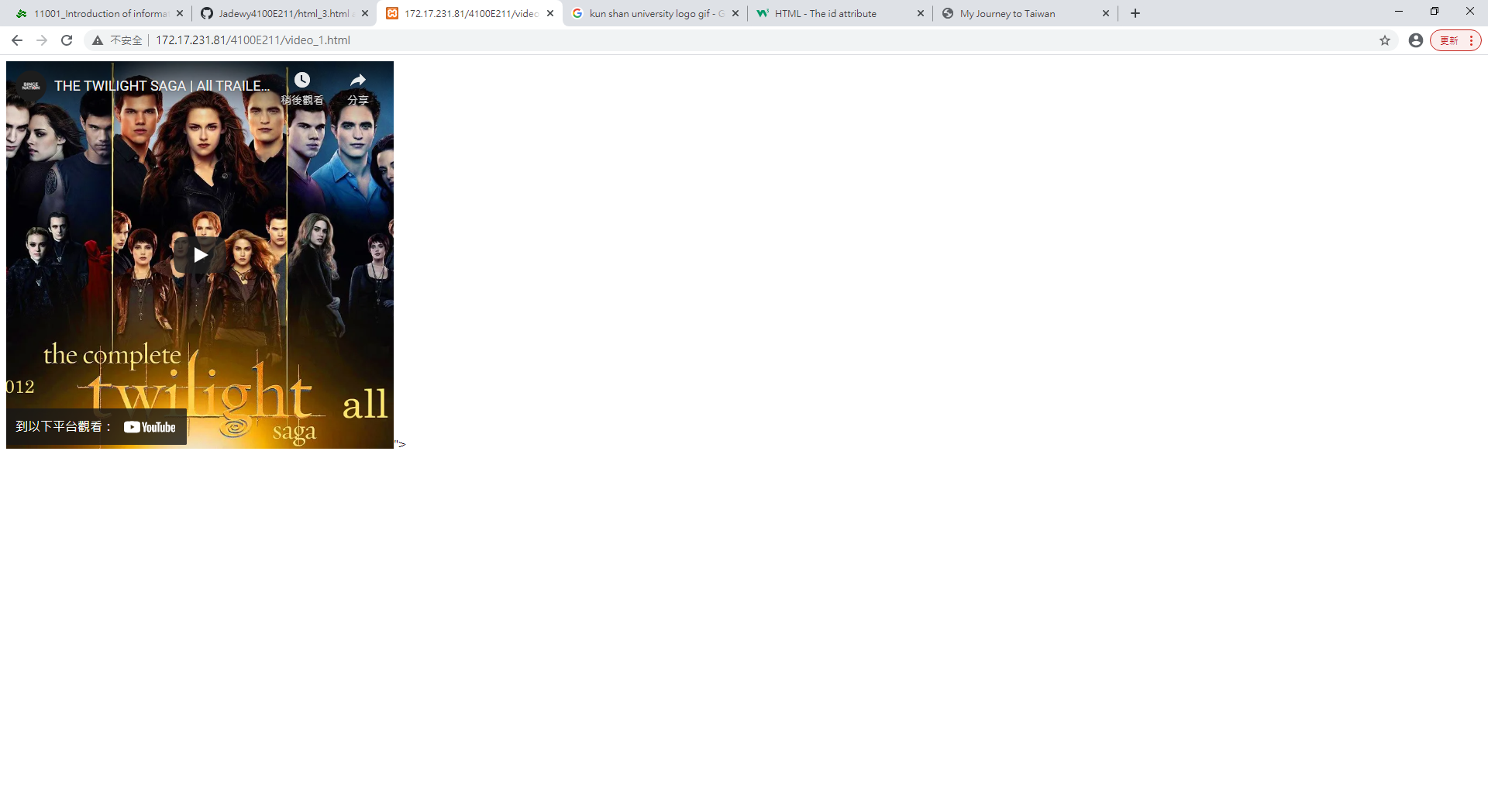
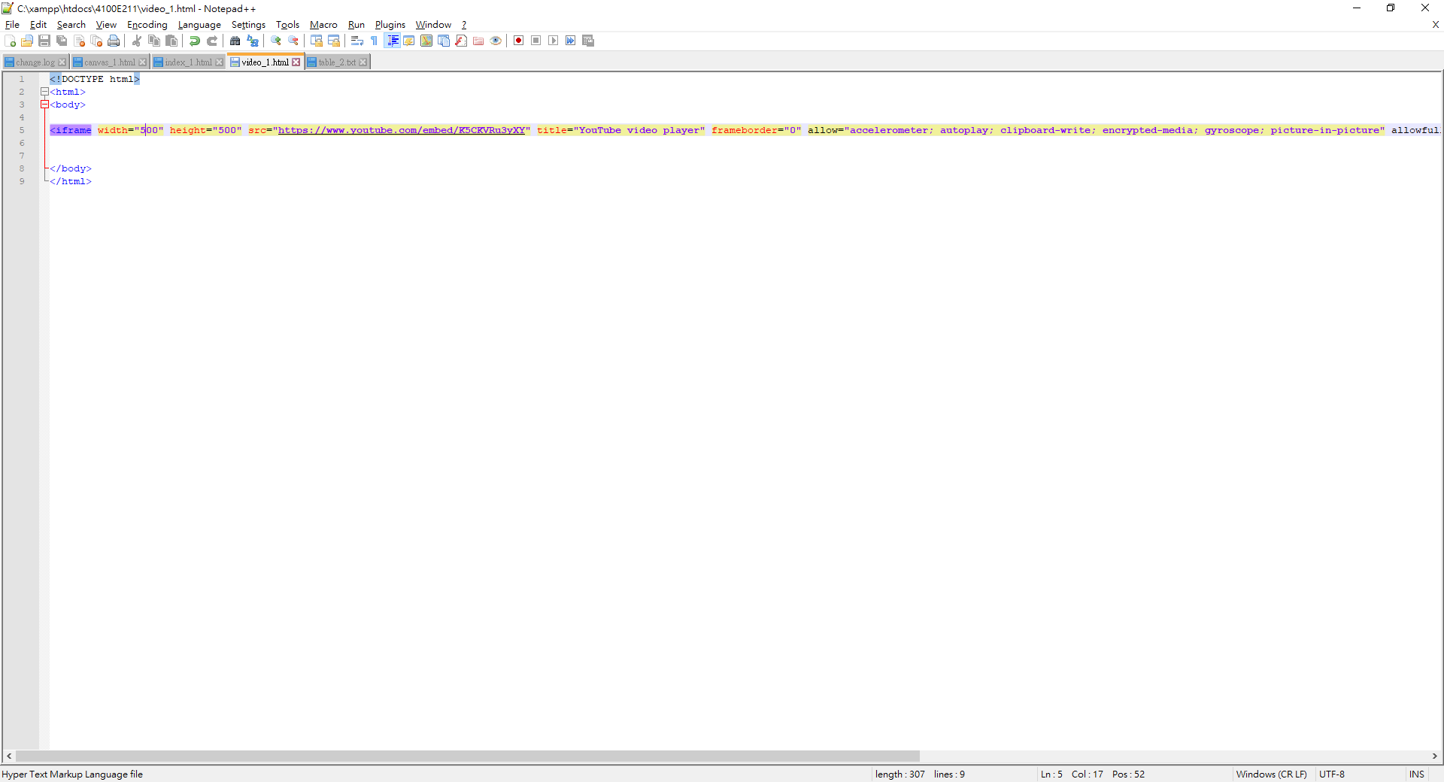
Video_1.html

Slide 13
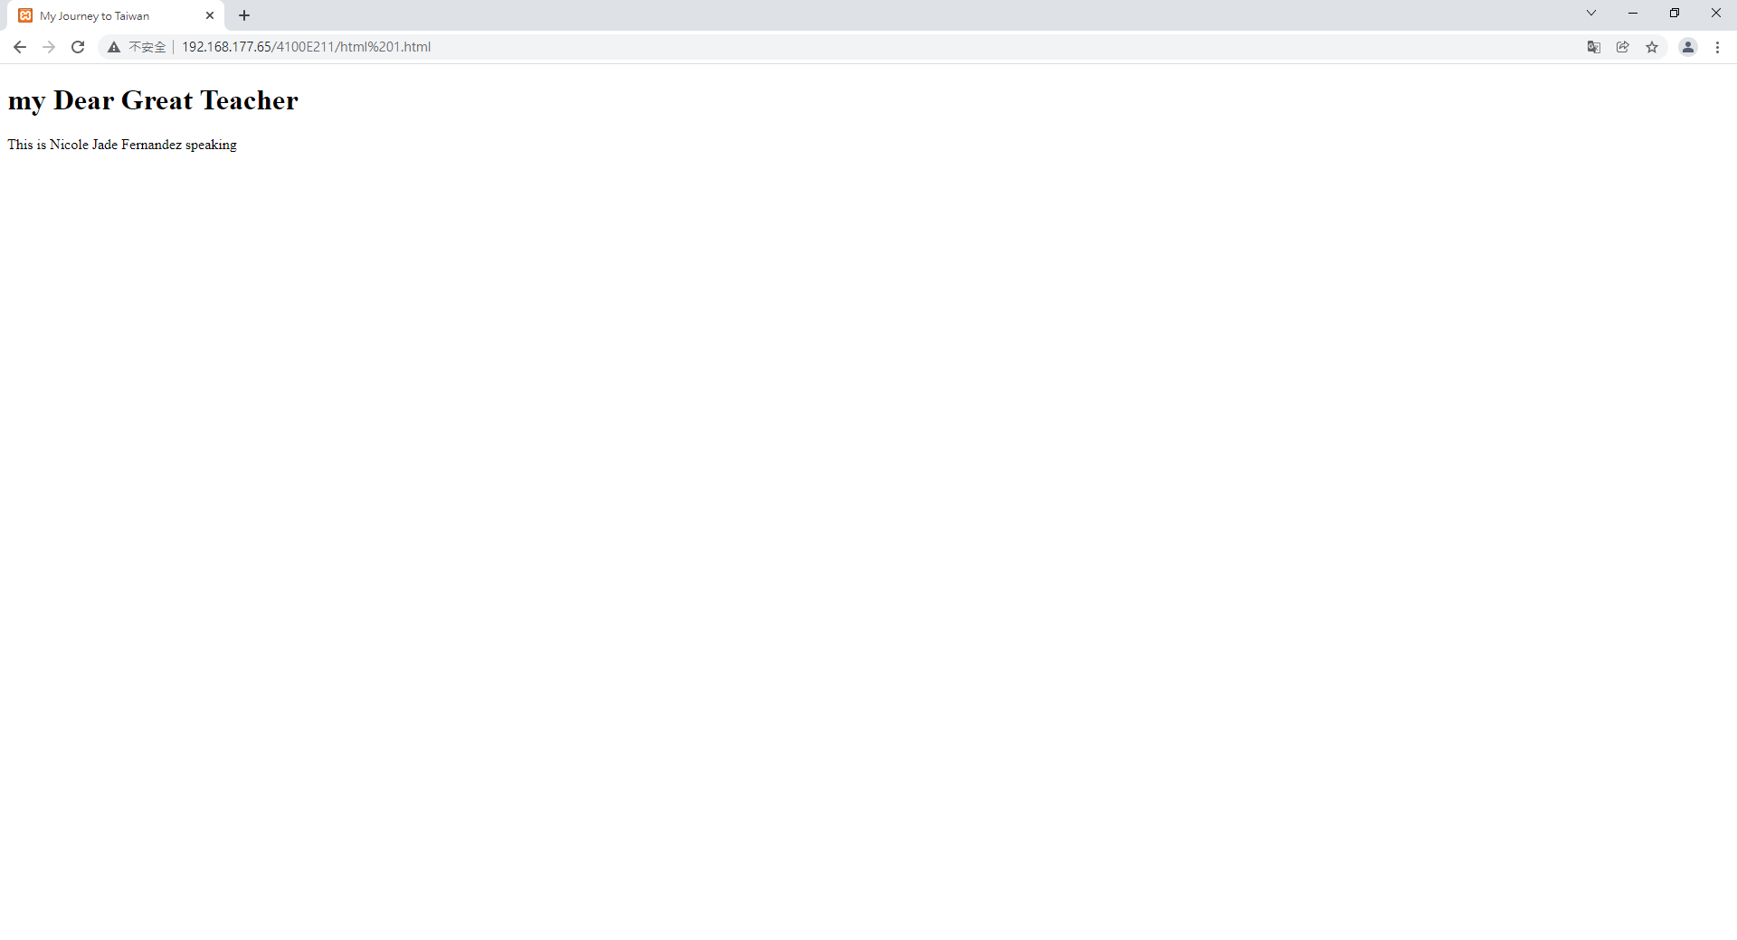
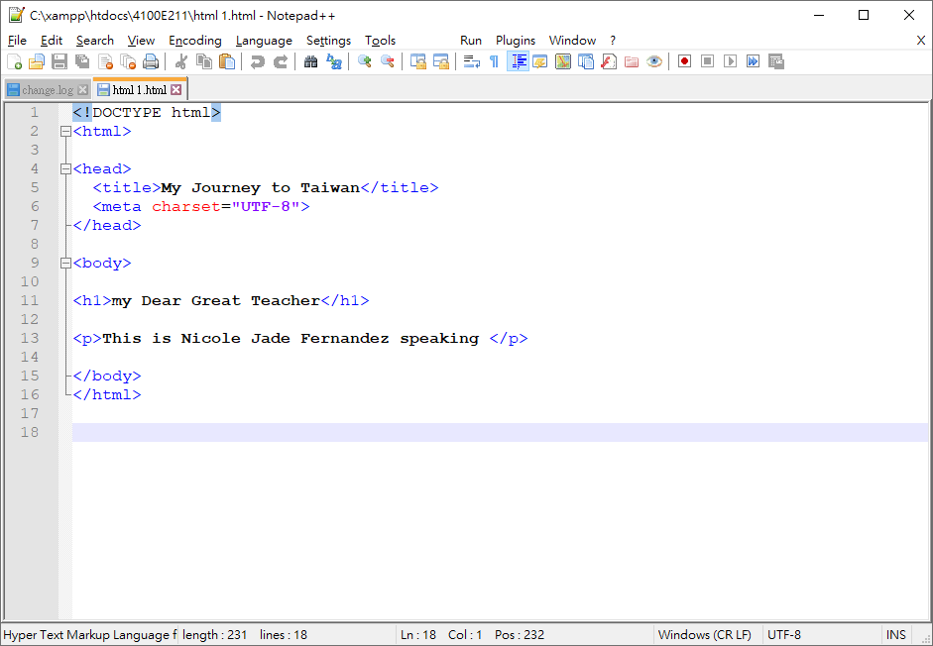
Html 1.html

Slide 14
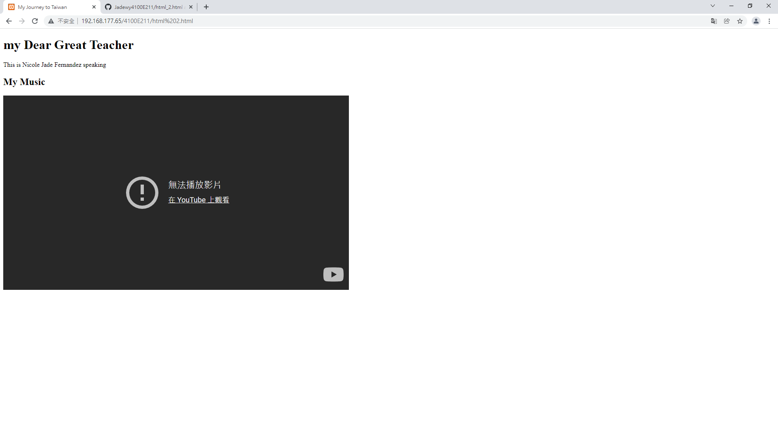
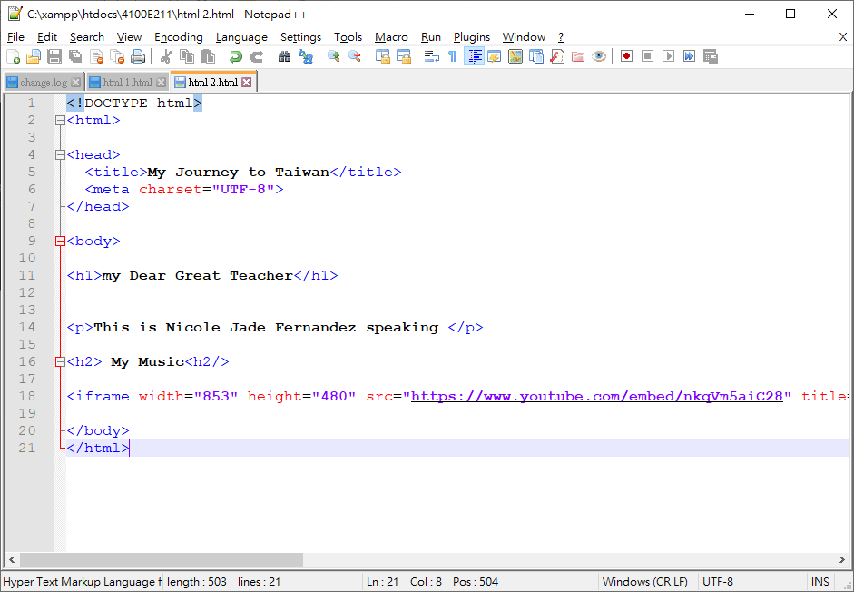
Html 2.html

Slide 15
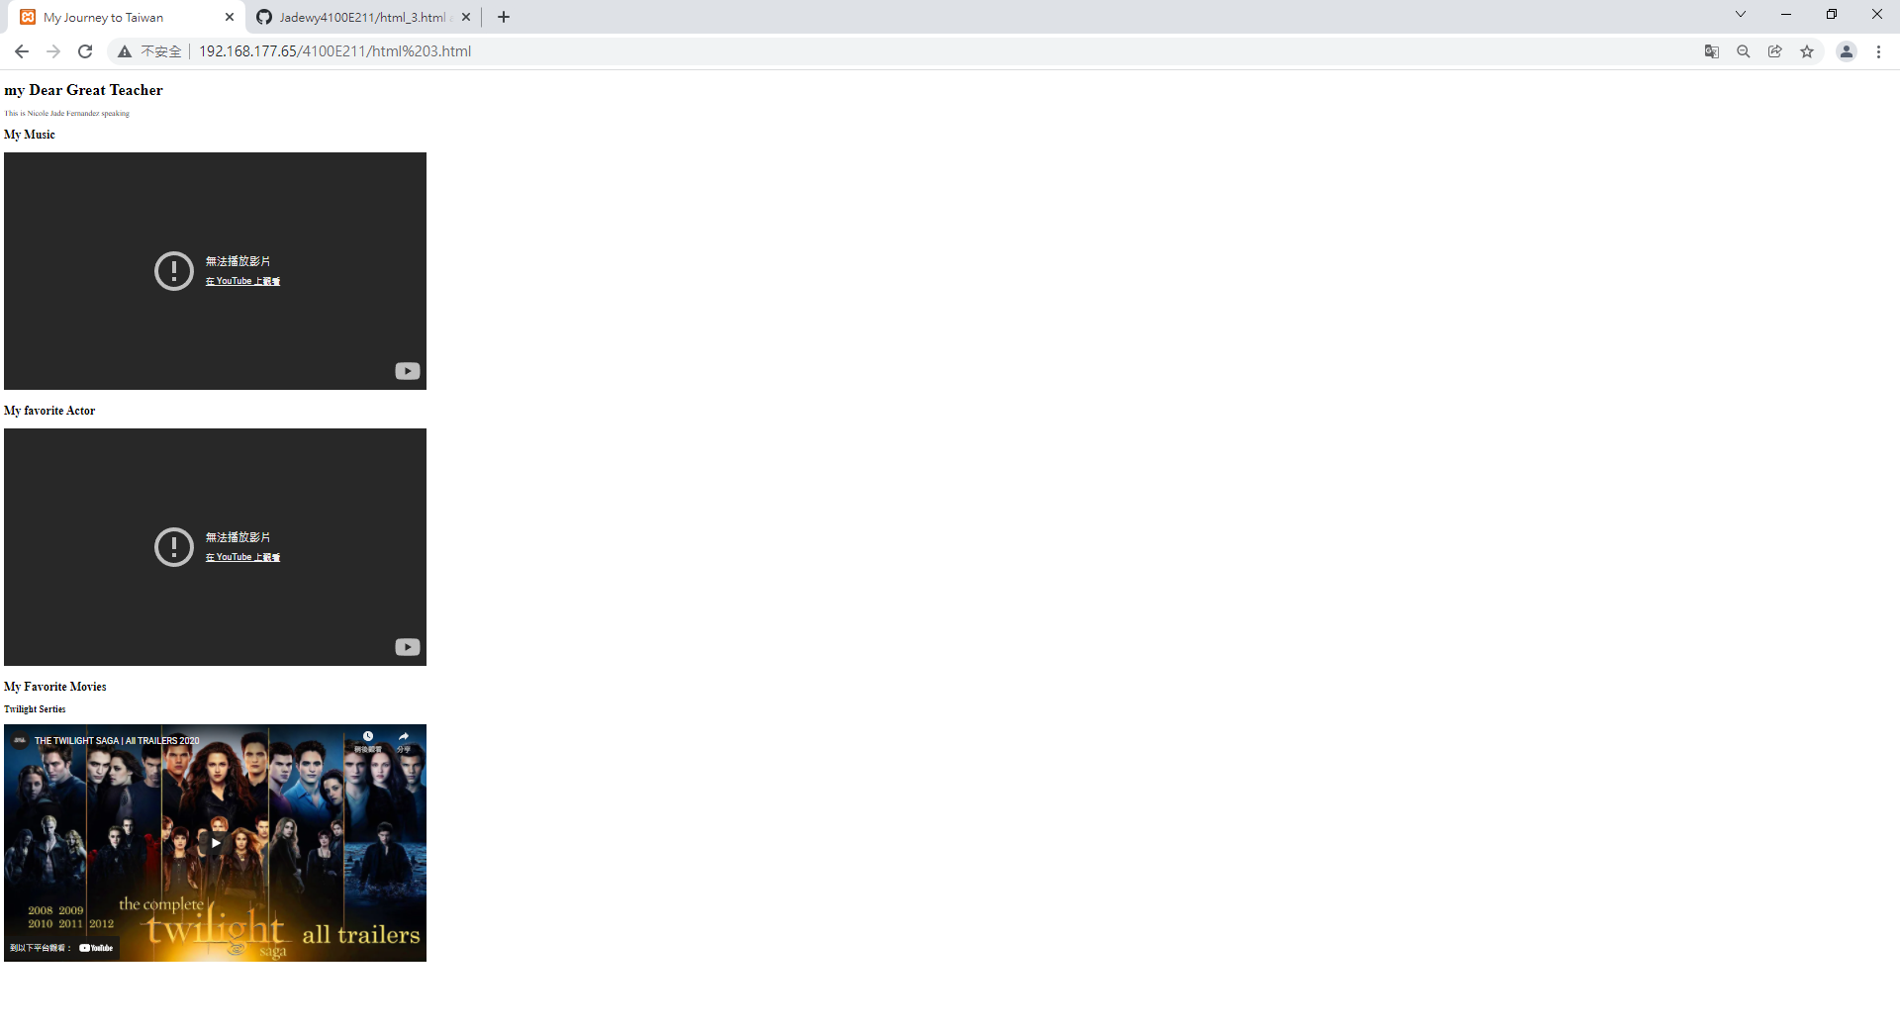
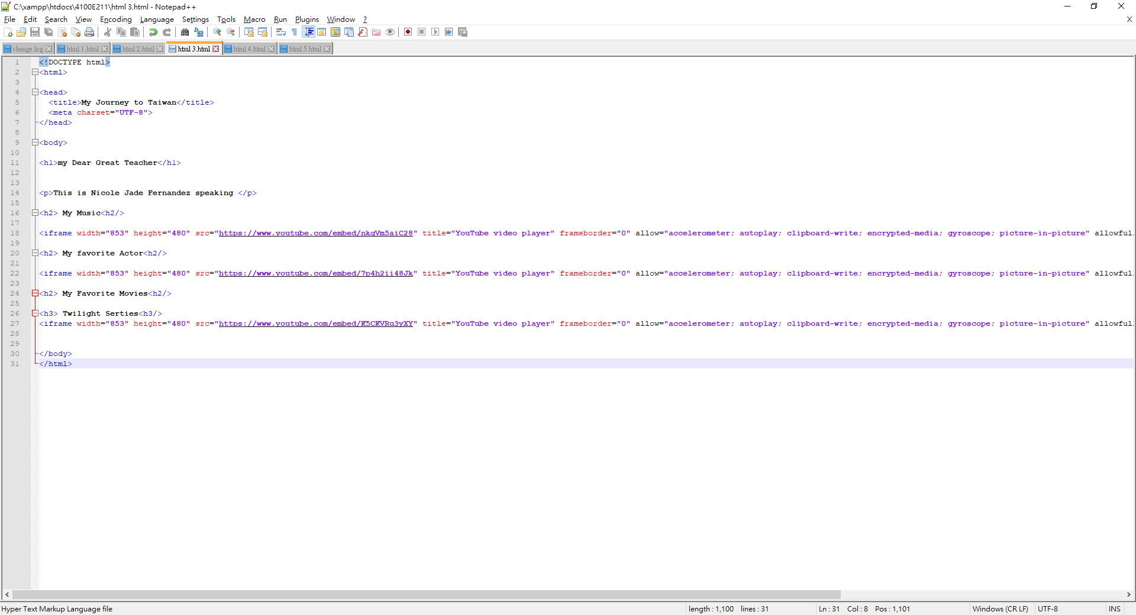
Html 3.html

Slide 16
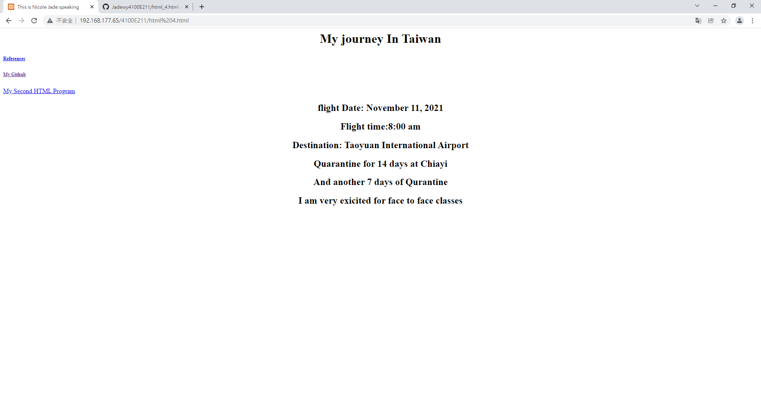
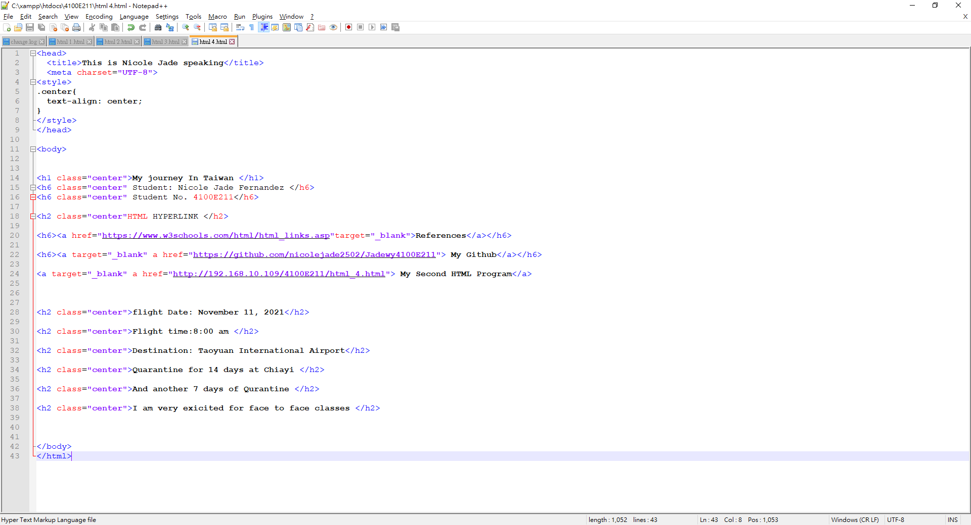
Html 4.html

Slide 17
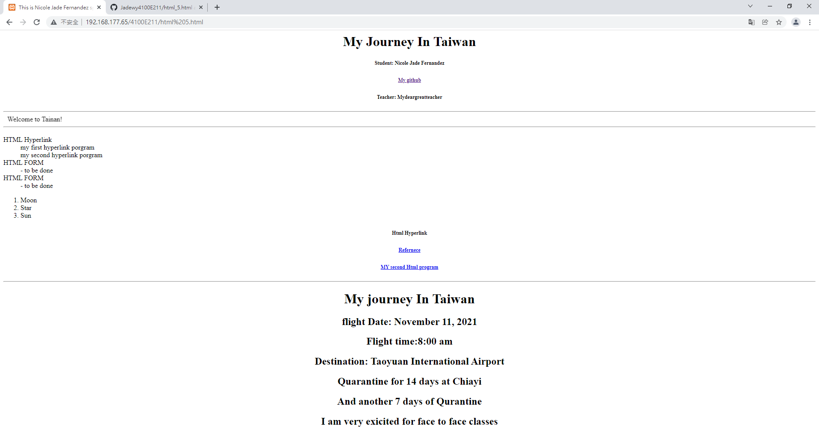
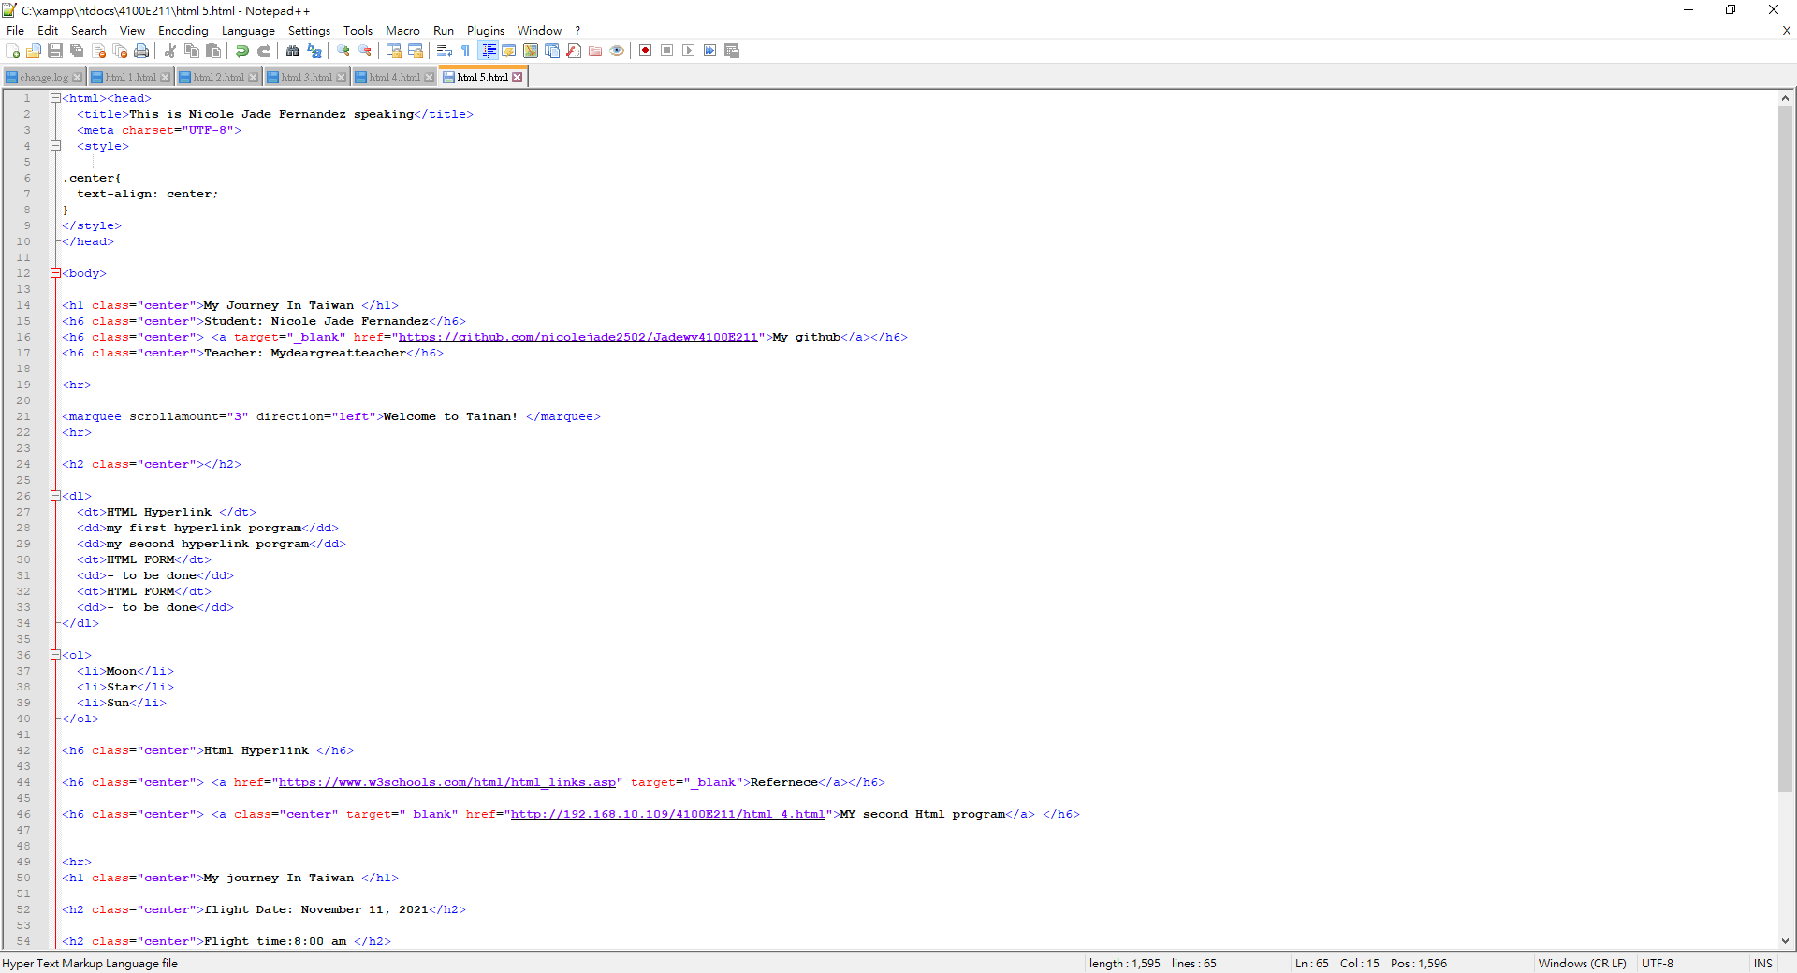
Html 5.html

Slide 18
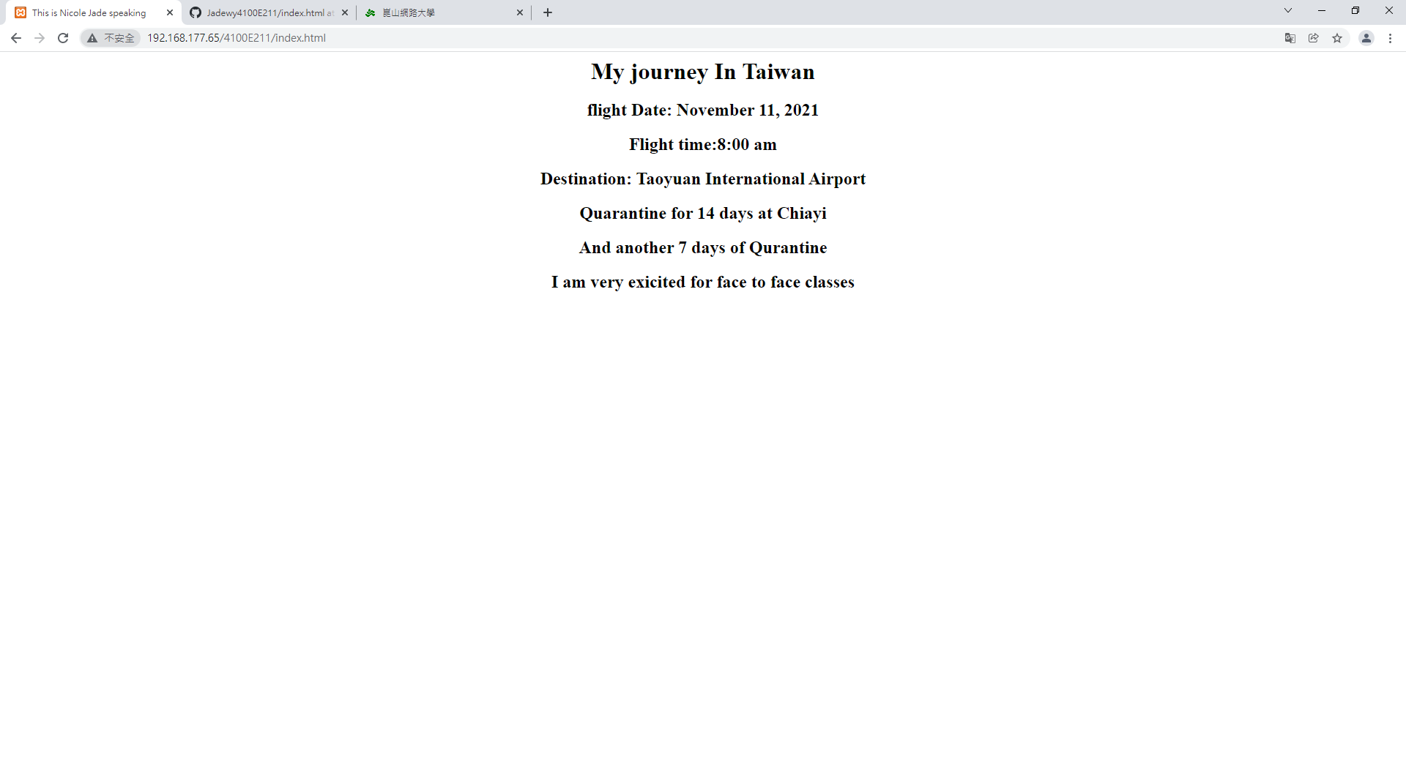
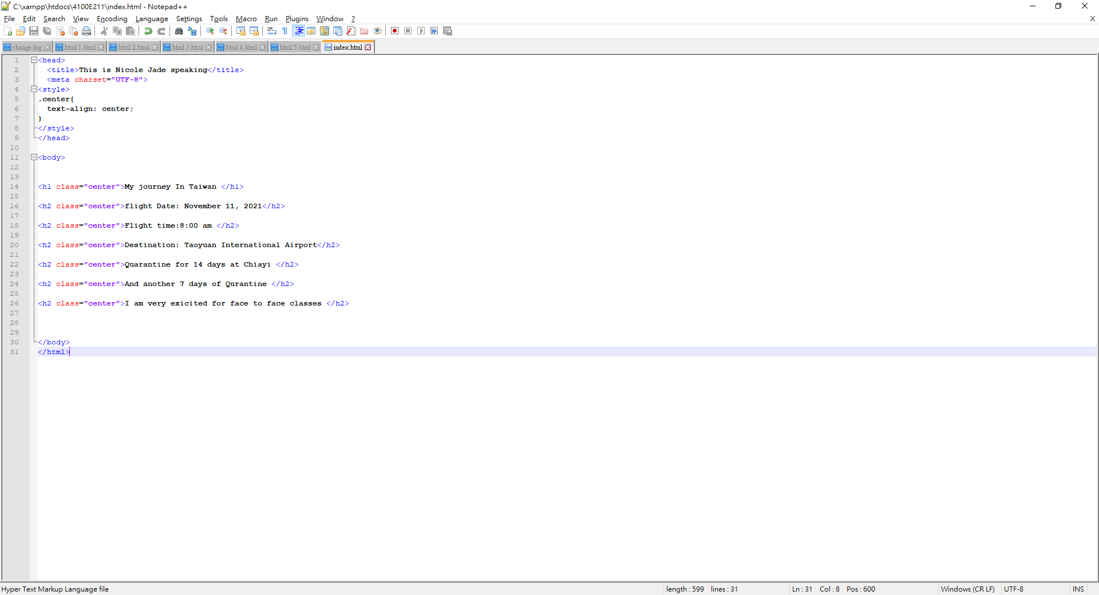
Index.html

Slide 19
Server-side programming

Slide 20
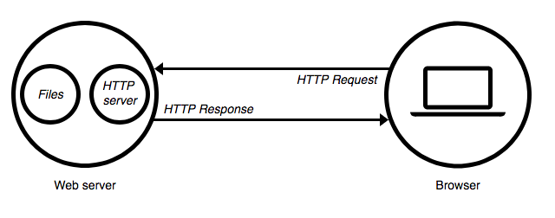
SERVER –SIDE PROGRAMMING https://medium.com/@BaaniLeen/web-development-series-intro-to-server-side-scripting-fe5626323f92
The server side programming is the name given to all types of programs which run on the web server. They process the user input, interact with the databases and control what content is served back to the client as a response to his request
Server-side processing happens when a page is first requested and when pages are posted back to the server. Examples of server-side processing are user validation, saving and retrieving data, and navigating to other pages.
It is written in a number of programming languages including PHP, NodeJS, Python, etc and has full access to the server’s OS and the programmer can chose the language he/she wants to code in.
Server-side programming is extremely useful as it helps to efficiently deliver user-customised content, and thus enhance the user experience. It can also be used to refine responses based on the user’s data (Data Analysis).

Slide 21
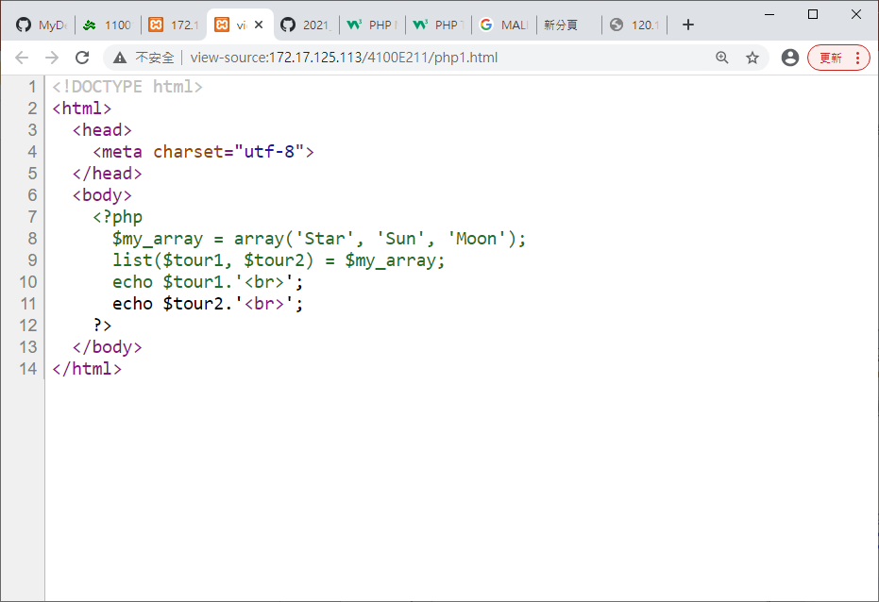
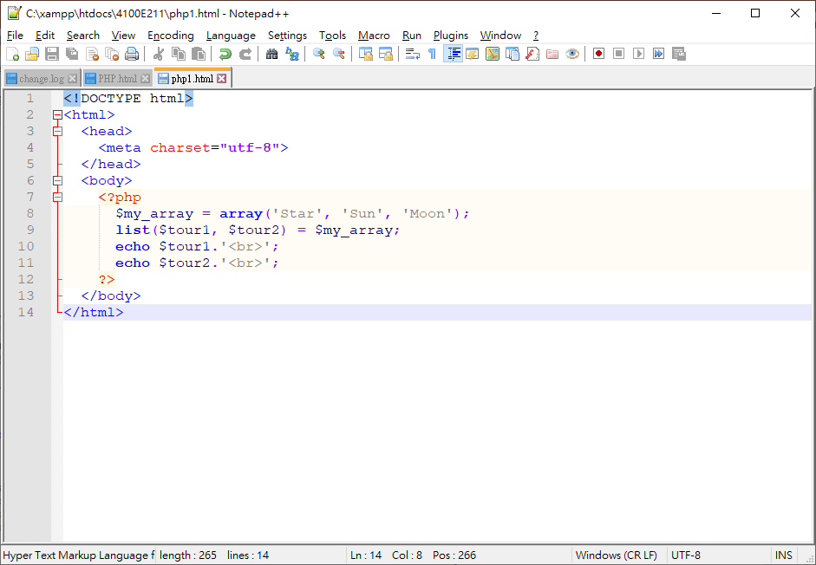
BROWSER
WHAT YOU SEE
ORIGINAL PHP PROGRAM
SERVER - SIDE PROGRAMMING

Slide 22
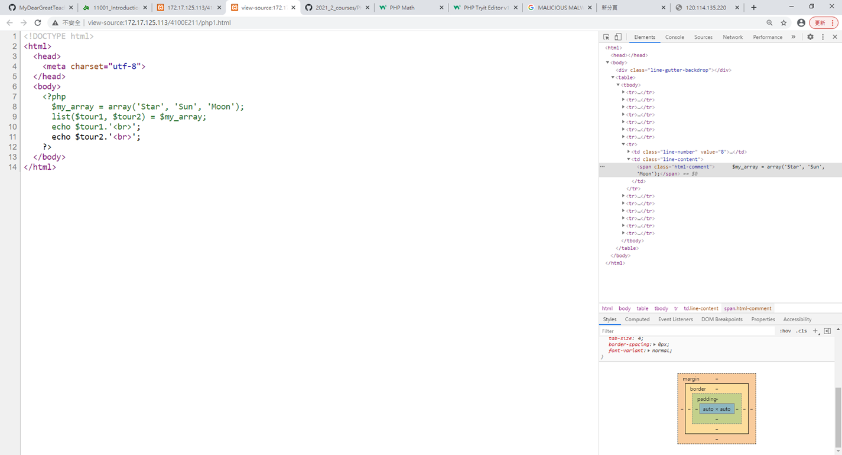
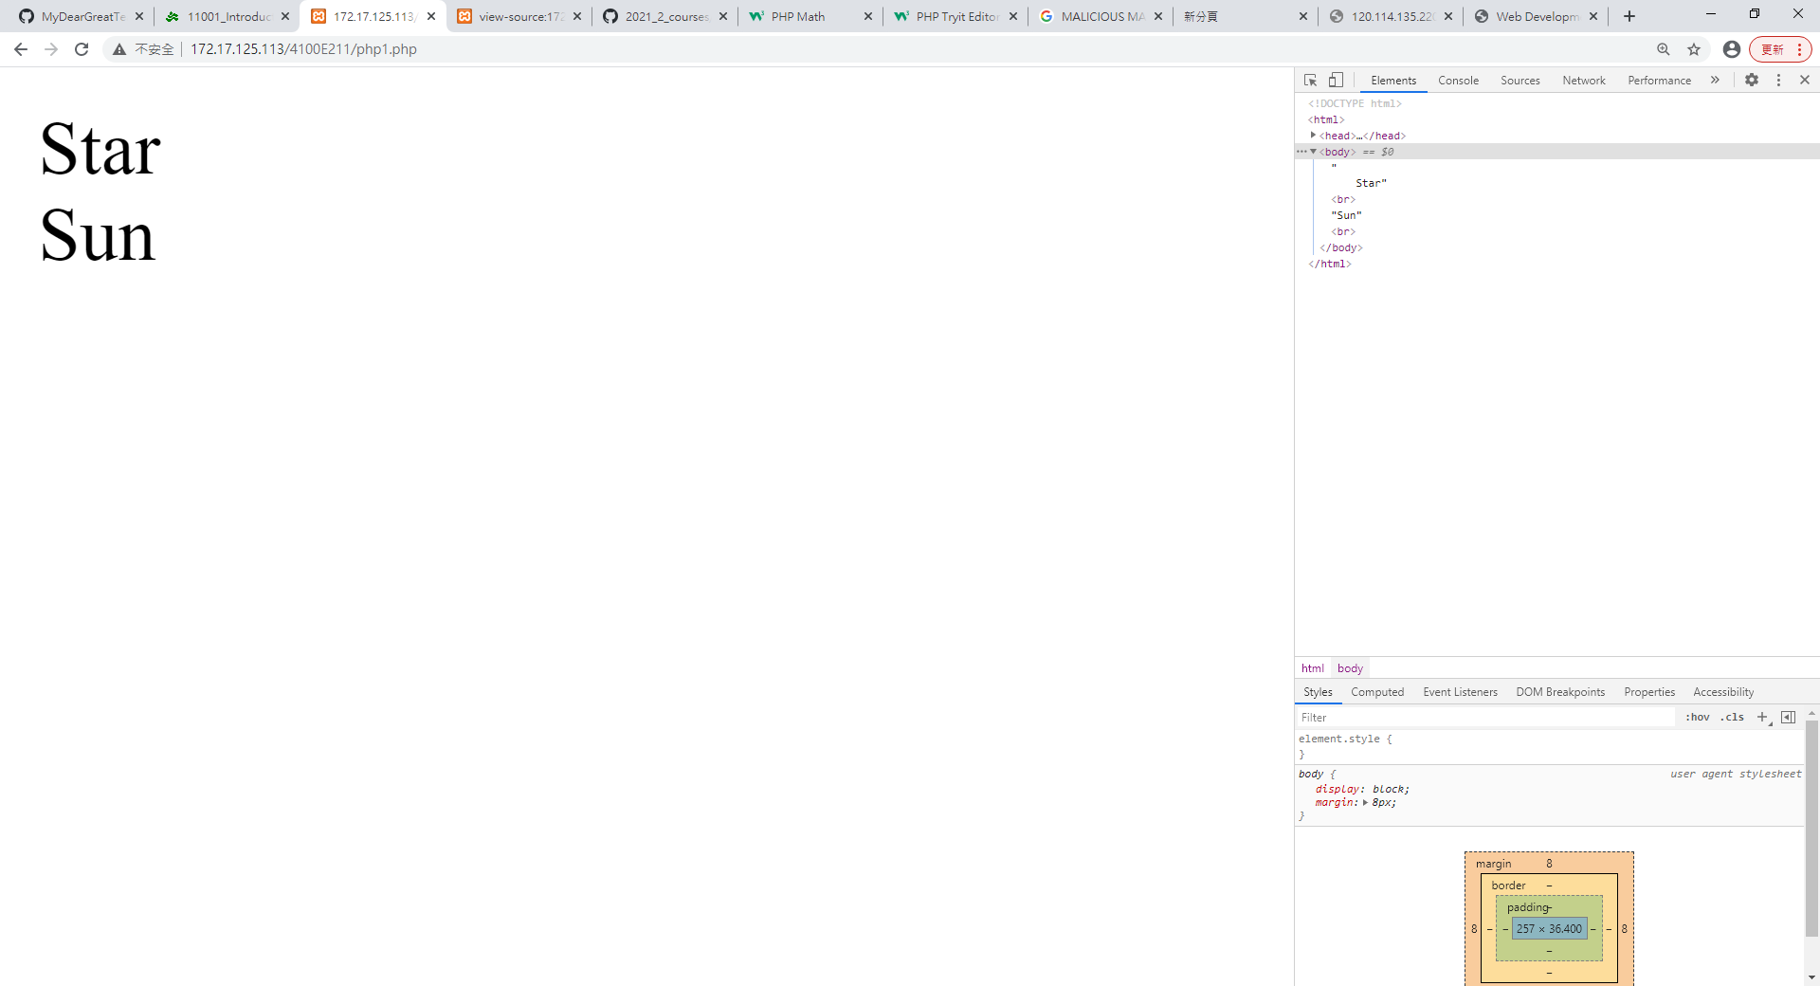
PHP1.PHP

Slide 23
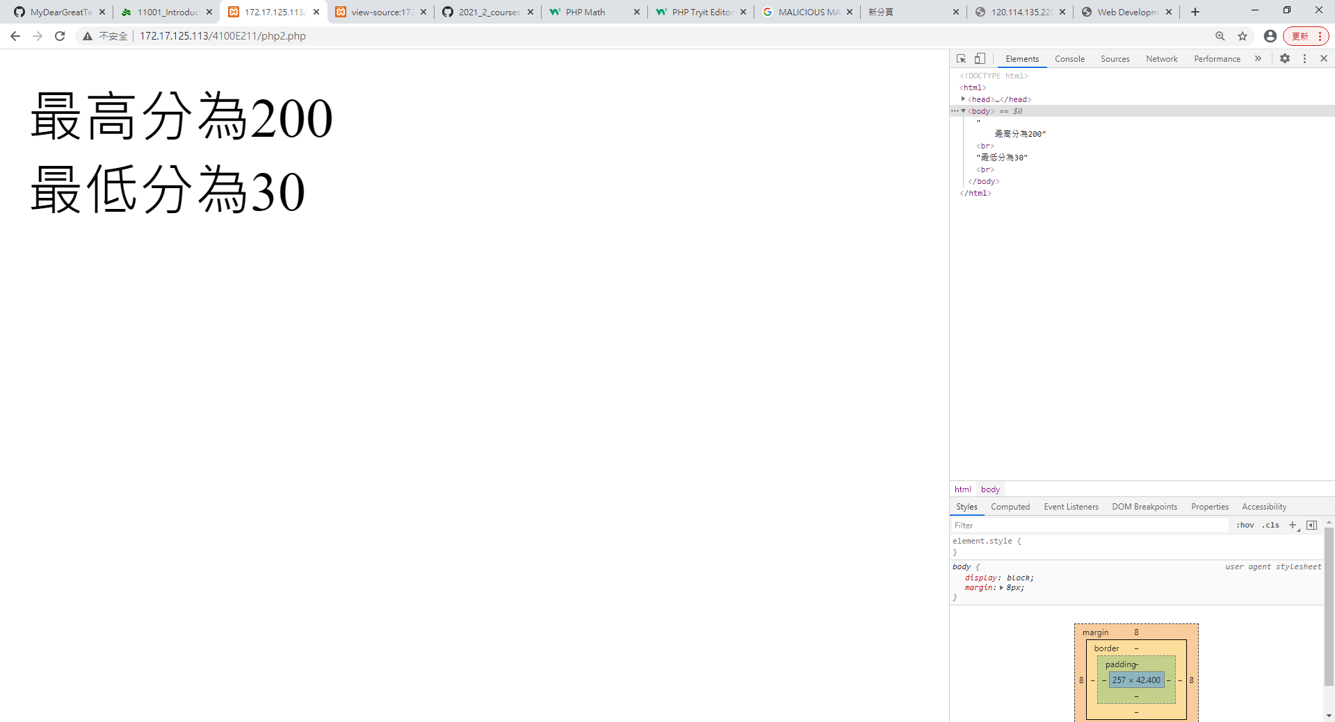
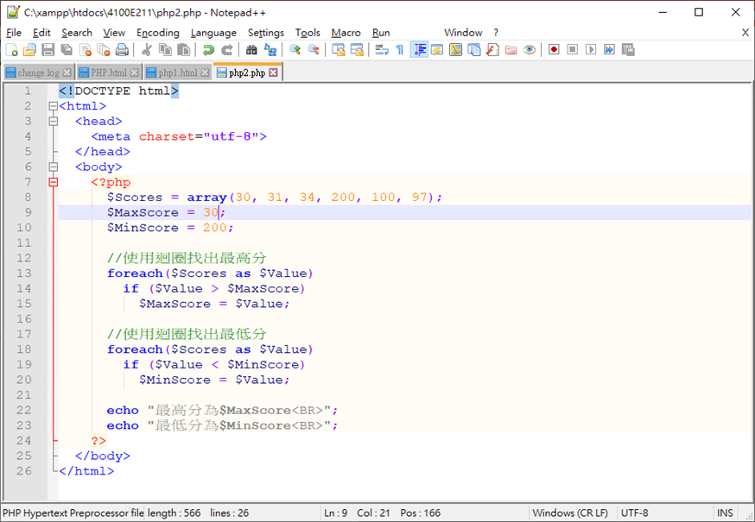
PHP2.PHP

Slide 24
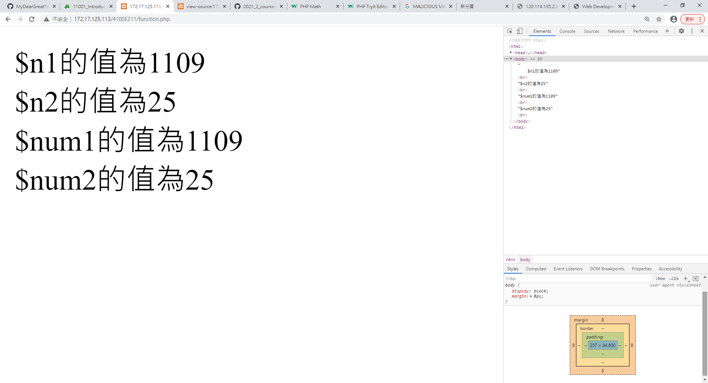
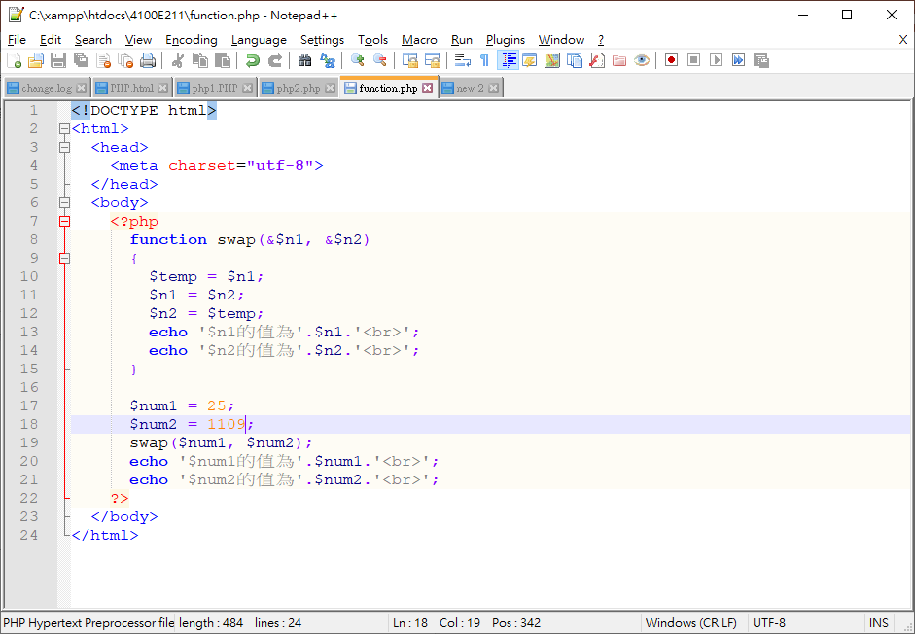
Function.php

Slide 25
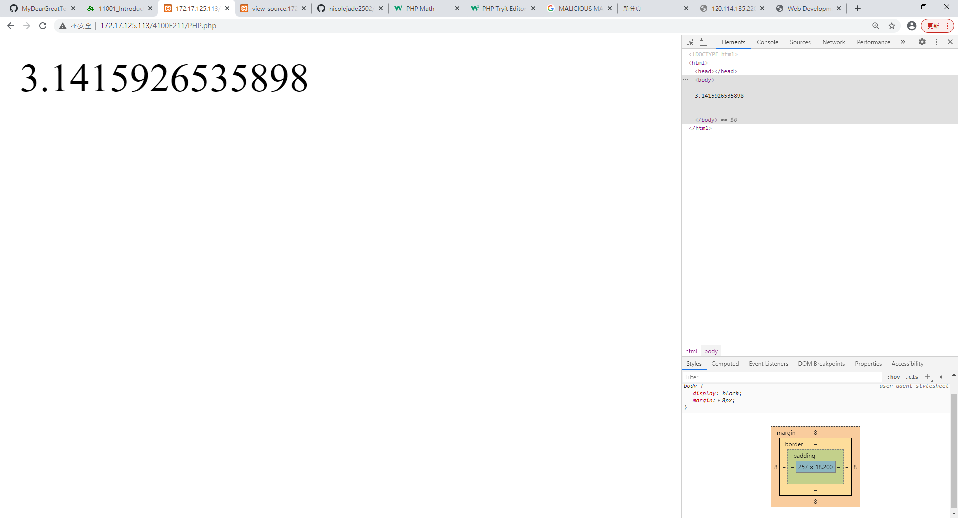
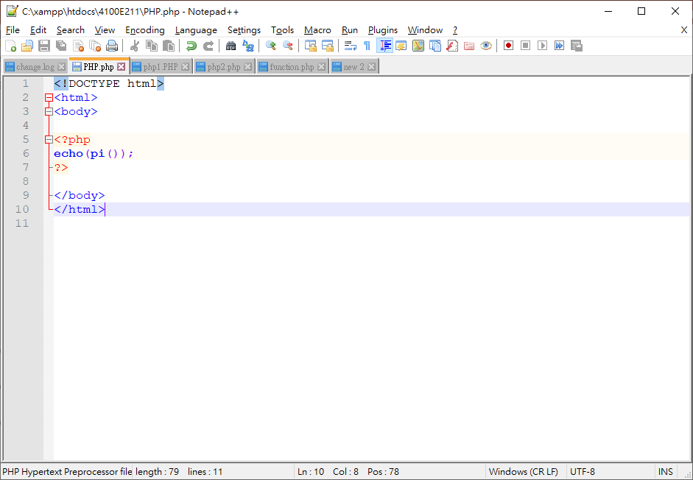
PHP.php

